Slide 1
Graph Plots
Kushal Sharma – Data Science Practitioner

Slide 2
Agenda
A Quick Revision
Histograms
Line Graphs
Scatterplots
Demonstration based on dataset in R for statistical concepts

Slide 3
Plotting Graphs
Plotting Graphs
Histograms
Line Graphs
Scatterplots

Slide 4
Histogram
A histogram represents the frequencies of values of a variable bucketed into ranges. Histogram is similar to bar chart but the difference is it groups the values into continuous ranges. Each bar in histogram represents the height of the number of values present in that range.

Slide 5
Histogram
R creates histogram using hist() function. This function takes a vector as an input and uses some more parameters to plot histograms.

Slide 6
Histogram – Syntax
The basic syntax for creating a histogram using R is:
hist(v,main,xlab,xlim,ylim,breaks,col,border)

Slide 7
Historam – Parameters Used
V
main
col
border
xlab
xlim
ylim
v is a vector containing numeric values used in histogram.
main indicates title of the chart.
col is used to set color of the bars.
border is used to set border color of each bar.
xlab is used to give description of x-axis.
xlim is used to specify the range of values on the x-axis.
ylim is used to specify the range of values on the y-axis. breaks is used to mention the width of each bar.

Slide 8
Histogram – Example
A simple histogram is created using input vector, label, col and border parameters.
The script given below will create and save the histogram in the current R working directory.
# Create data for the graph.
v <- c(9,13,21,8,36,22,12,41,31,33,19)
# Give the chart file a name.
png(file = "histogram.png")
# Create the histogram.
hist(v,xlab="Weight",col="yellow",border="blue")
# Save the file.
dev.off()

Slide 9
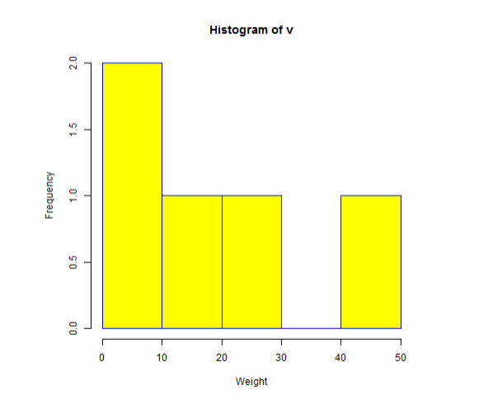
Output

Slide 10
Line Graphs
A line chart is a graph that connects a series of points by drawing line segments between them. These points are ordered in one of their coordinate (usually the x-coordinate) value. Line charts are usually used in identifying the trends in data.

Slide 11
Line Graphs
The plot() function in R is used to create the line graph.

Slide 12
Line Graph – Syntax
The basic syntax to create a line chart in R is:
plot(v,type,col,xlab,ylab)

Slide 13
Line Graph - Parameters
v
v is a vector containing the numeric values.
type
type takes the value "p" to draw only the points, "i" to draw only the lines and "o" to draw both points and lines.
xlab
xlab is the label for x axis.
ylab
ylab is the label for y axis.
main
main is the Title of the chart.
col
col is used to give colors to both the points and lines.

Slide 14
Line Graphs - Example
A simple line chart is created using the input vector and the type parameter as "O". The below script will create and save a line chart in the current R working directory.
# Create the data for the chart.
v <- c(7,12,28,3,41)
# Give the chart file a name.
png(file = "line_chart.jpg")
# Plot the bar chart.
plot(v,type="o")
# Save the file.
dev.off()

Slide 15
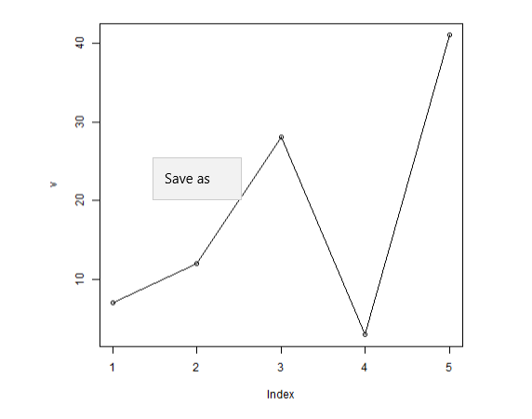
Output

Slide 16
Scatterplots
Scatterplots show many points plotted in the Cartesian plane. Each point represents the values of two variables. One variable is chosen in the horizontal axis and another in the vertical axis.

Slide 17
ScatterPlot
The simple scatterplot is created using the plot() function.

Slide 18
Scatterplot – Syntax
The basic syntax for creating scatterplot in R is :
plot(x, y, main, xlab, ylab, xlim, ylim, axes)

Slide 19
Scatterplot – Parameters
x is the data set whose values are the horizontal coordinates.
y is the data set whose values are the vertical coordinates.
main is the tile of the graph.
xlab is the label in the horizontal axis.
ylab is the label in the vertical axis.
xlim is the limits of the values of x used for plotting.
ylim is the limits of the values of y used for plotting.
axes indicates whether both axes should be drawn on the plot.
x
y
main
xlab
ylab
xlim
ylim
axes

Slide 20
Scatterplot – Examples
We use the data set "mtcars" available in the R environment to create a basic scatterplot. Let's use the columns "wt" and "mpg" in mtcars.
input <- mtcars[,c('wt','mpg')]
print(head(input))
When we execute the above code, it produces the following result:
wt mpg
Mazda RX4 2.620 21.0
Mazda RX4 Wag 2.875 21.0
Datsun 710 2.320 22.8
Hornet 4 Drive 3.215 21.4
Hornet Sportabout 3.440 18.7
Valiant 3.460 18.1

Slide 21
Creating the Scatterplot
The below script will create a scatterplot graph for the relation between wt(weight) and mpg(miles per gallon).
# Get the input values.
input <- mtcars[,c('wt','mpg')]
# Give the chart file a name.
png(file = "scatterplot.png")
# Plot the chart for cars with weight between 2.5 to 5 and mileage between 15 and 30.
plot(x=input$wt,y=input$mpg,
xlab="Weight",
ylab="Milage",
xlim=c(2.5,5),
ylim=c(15,30),
main="Weight vs Milage"
)
# Save the file.
dev.off()

Slide 22
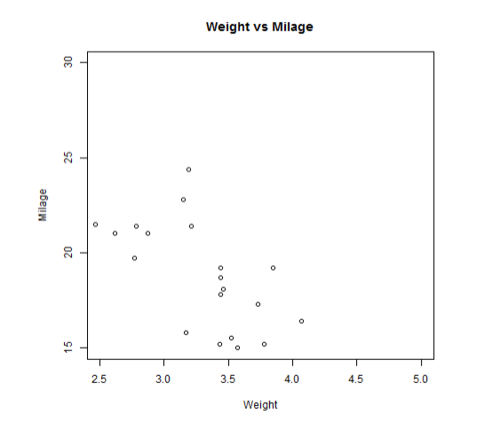
Output

Slide 23
Discussion Q&A
Thank You!

